Slide 1
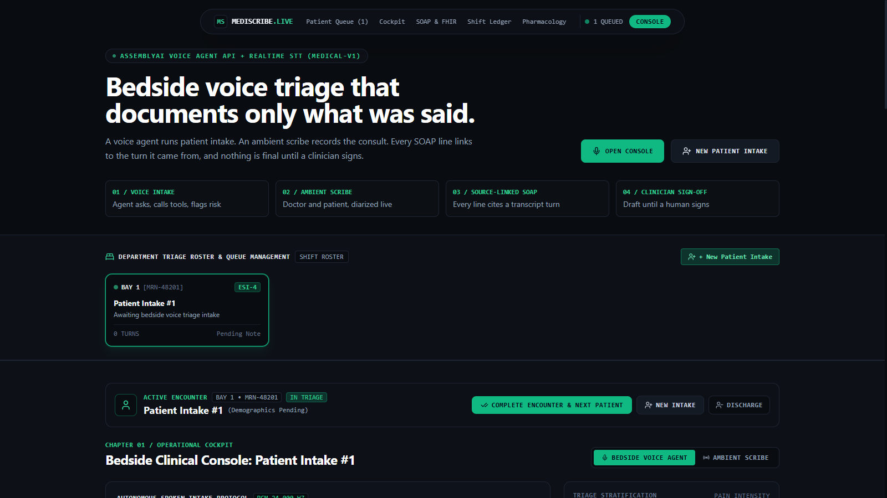
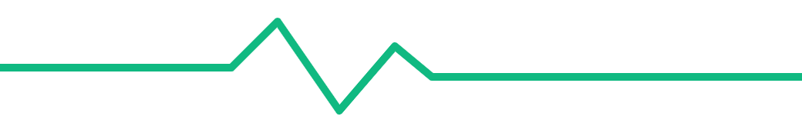
ASSEMBLYAI VOICE AGENT HACKATHON
MediScribe Live
Bedside voice triage that documents only what was said.
mediscribe.rhasan.online · github.com/Daddy-Ousen/mediscribe-live
Notes:
MediScribe Live is a voice-first assistant for the emergency department. A voice agent does the bedside intake. An ambient scribe records the consult. The SOAP note it writes links every line back to the words that were said, and nothing is final until a clinician signs.

Slide 2
THE PROBLEM
Notes take the shift. Unchecked AI notes take the trust.
49%
AI scribes write fast. Clinicians still cannot trust them.
of physicians' time in the clinic went to EHR and desk work. Only 27% went to direct time with patients.
A generated note can add an allergy, a dose or a diagnosis that nobody said.
If a line has no source, the clinician must re-check the whole note. The time saving is lost.
Sinsky et al., Annals of Internal Medicine, 2016
Notes:
The burden is real: in the Sinsky time-and-motion study, about half of clinic time went to EHR and desk work. AI scribes help with speed, but the trust problem stays. If you cannot see where a line came from, you must check everything.

Slide 3
THE WORKFLOW
Four steps, one patient chart
01
02
03
04
Voice intake
Ambient scribe
Source-linked SOAP
Clinician sign-off
A voice agent talks with the patient and calls clinical tools.
Records the consult. Separates doctor and patient.
Draft until a named clinician signs. Exports HL7 FHIR R4.
Every line cites the transcript turn it came from.
Voice Agent API
Streaming STT
FHIR Bundle
LLM Gateway
Both voice modes write to the same chart: name, complaint, vitals, medicines, allergies and ESI acuity.
Notes:
Walk the four cards left to right. Steps one and two are the two voice modes. Step three is the note. Step four keeps a human in charge.

Slide 4
01 · ASSEMBLYAI VOICE AGENT API
The voice agent runs bedside intake
Full-duplex talk over one WebSocket. The patient can interrupt, and the agent stops speaking at once.
record_patient_intake
Name, age, complaint, pain score and vitals go into the chart.
While it talks, the agent calls tools. The chart and the alerts update live.
check_drug_interaction
Example: warfarin + aspirin raises a bleeding-risk alert.
flag_critical_vital
An unsafe vital sign flags the patient and raises the ESI level.
Latency is measured, not claimed
The panel shows the time from end of speech to the first agent audio: last value and median.
Notes:
In the demo, say: my name is John Miller, crushing chest pain nine out of ten, I take warfarin and I took aspirin. The name updates, ESI goes to 2, and the drug alert fires. Point at the latency panel.

Slide 5
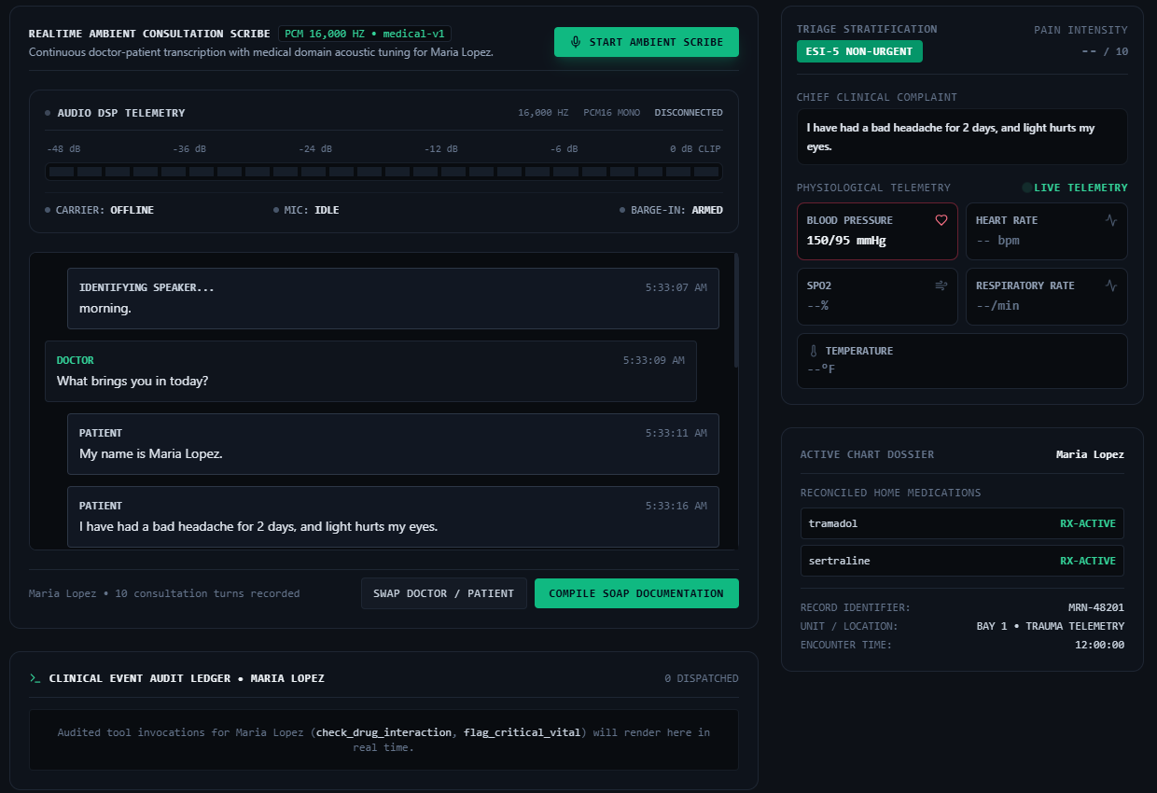
02 · STREAMING STT
The scribe hears who said what
Universal-3.5 Pro with the medical-v1 domain for drug and body terms
Speaker labels split Doctor and Patient; one click swaps them
Final turns fill the chart: name, complaint, vitals, medicines
Notes:
This is a real run of our test consult. The patient Maria Lopez gives her name, a two-day headache, a sulfa allergy and two home medicines. The chart fills from the final turns only.

Slide 6
03 · THE CORE IDEA
Every SOAP line points to the words that were said.
Notes:
This is the one idea to remember. If a line cannot point to a transcript turn, the note says so.

Slide 7
HOW CITATIONS ARE CHECKED
The server checks the model's sources
T1 … Tn
evidence
verify
NO SOURCE
Number the turns
Model cites turns
Check each citation
Flag the rest
Each transcript turn gets an id before the model sees it.
The model returns the note plus a map: item to turn ids.
Word overlap with the real turn text. Wrong ids are fixed or dropped.
Items with no source are marked "NO SOURCE - VERIFY".
In the note, each T-chip opens the exact quote. The clinician checks a line in one click.
Notes:
We do not trust the model's citations. The server re-checks every one against the turn text. This is the part that makes the note auditable.

Slide 8
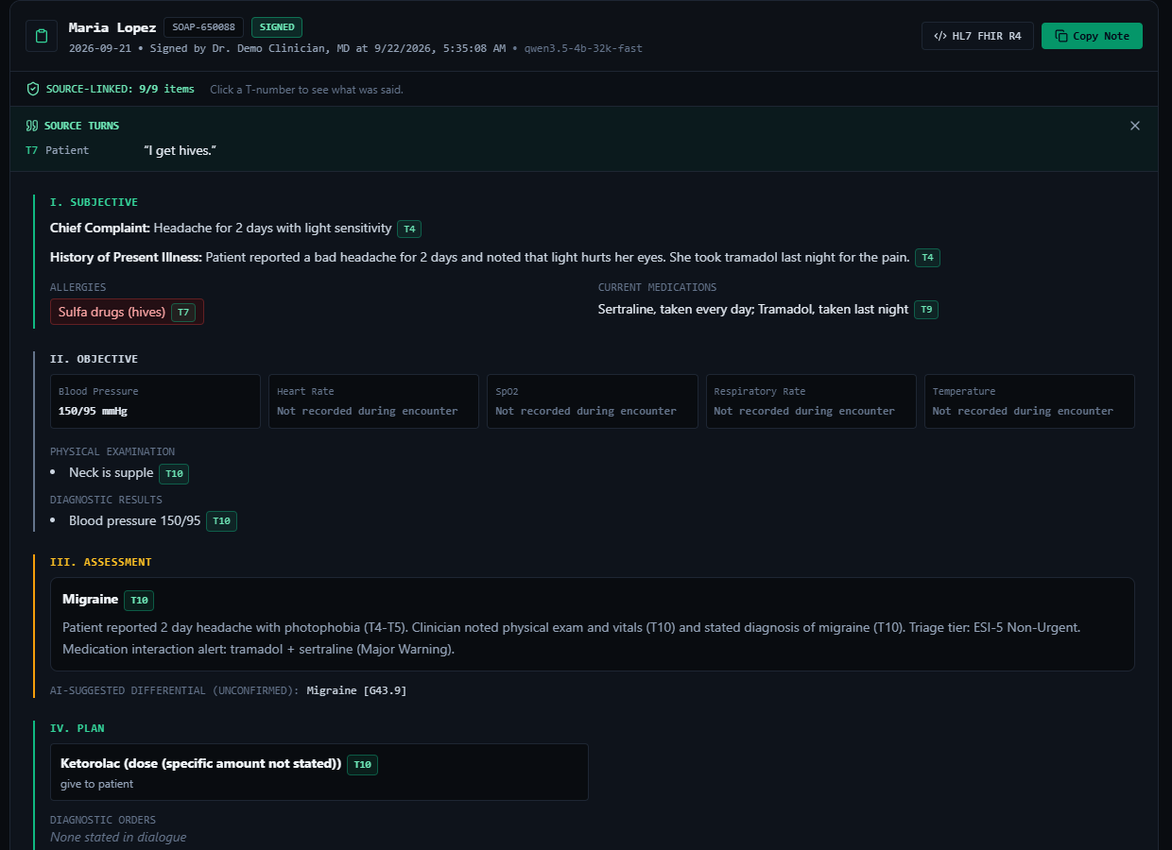
REAL TEST RUN
9 of 9 items linked to a source
Click T7 and the note shows the quote: "I get hives."
Vitals nobody said stay "Not recorded during encounter".
After sign-off the note shows SIGNED, the clinician's name and the time.
Notes:
This is the SOAP note from the same test consult, after sign-off. Nine of nine items have a verified source. Heart rate, SpO2 and temperature were not said, so the note does not invent them.

Slide 9
GUARDRAILS
Rules the note cannot break
If… | The note does this
A topic was not discussed | Says "Not discussed during encounter"
No allergy was stated | Leaves it open. Never defaults to NKDA
No diagnosis was stated | Shows no diagnosis or ICD code
The AI suggests a differential | Labels it "AI-suggested (unconfirmed)"
The LLM call fails | Makes no note. No template fallback
Nobody has signed yet | Stays DRAFT; FHIR Composition is "preliminary"
A clinician signs | FHIR Composition becomes "final" with an attester
Notes:
These rules are in the server code, not only in the prompt. For example, if the LLM fails, the route returns an error instead of a fake note.

Slide 10
ARCHITECTURE
The API key never reaches the browser
Voice Agent API
24 kHz PCM · tool calls · barge-in
Browser
direct WebSockets
Streaming STT v3
Next.js 14 + React. Web Audio: mic to PCM16, fixed 100 ms frames.
short-lived token
16 kHz · universal-3-5-pro · medical-v1
LLM Gateway, via our server
SOAP + evidence map · citation check
Next.js API routes mint the tokens and call the LLM. Deployed on Vercel.
Notes:
The browser streams audio straight to AssemblyAI for low overhead. Our server only mints tokens, runs the drug check, and makes the SOAP note.

Slide 11
BUSINESS VALUE
Faster notes that can pass an audit
Who it is for
Next steps
Emergency departments and urgent care
Clinicians: less typing, one-click checks
Hospitals: every line has an audit trail
EHR teams: standard HL7 FHIR R4 output
A stronger LLM for SOAP synthesis
A full drug database in place of the demo list
HIPAA-ready hosting and a pilot with one clinic
Write signed notes back into the EHR
Hackathon prototype. Not a medical device. The drug-interaction list is a small demo set.
Notes:
The value is time and trust together. Next steps are honest: better model access, a real drug database, compliant hosting and a pilot.

Slide 12
Try MediScribe Live
mediscribe.rhasan.online
github.com/Daddy-Ousen/mediscribe-live
Built with AssemblyAI Voice Agent API, Streaming STT and LLM Gateway. MIT License.
Notes:
Thank you. The app is live, and the code is open source under MIT.

